Slide 1
Lunch and Learn Basics of GitHub 3/24/2020
Lots of documentation and help, all in one place:
https://help.github.com/en/github

Slide 2
Outline
Getting signed up
Making your first repository
Adding files to your repository
Making Changes to files
Creating a Branch
Merging side Branch to master branch
Forking
Downloading/cloning a repository

Slide 3
Creating an account/login
Create an account of GitHub to get started!
Sign up
Install GitHub desktop (optional)
Install

Slide 4
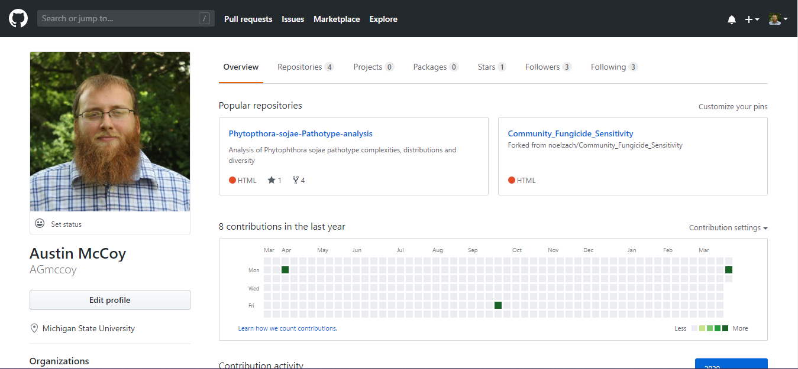
Making a new repository!

Slide 5
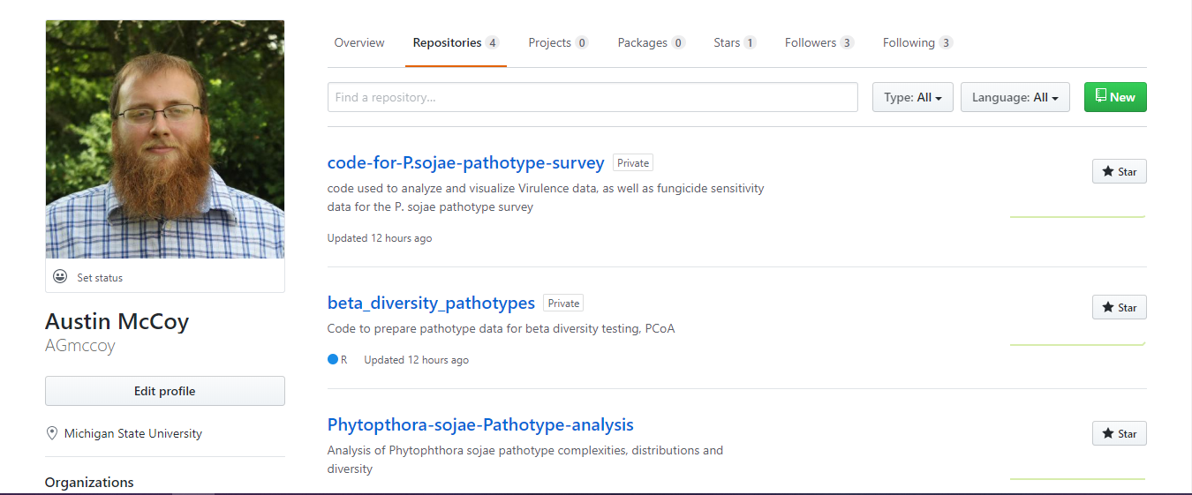

Slide 6
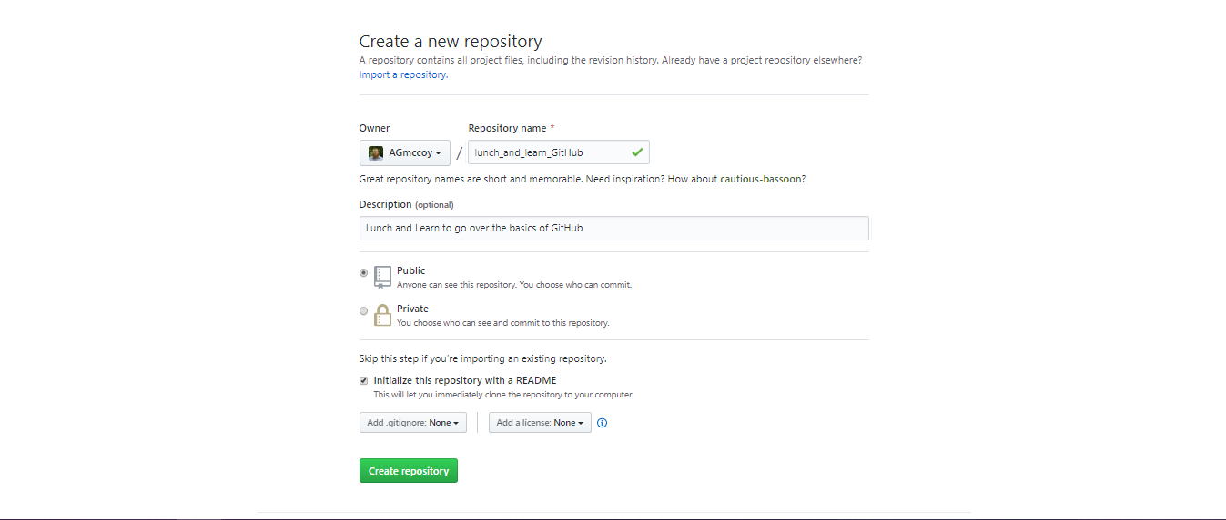
Public: code for a published paper, collaborations, etc
Private: code for a paper you are working on that’s not published, manuscript versions, etc
Notes:
Give it a good name and description
Public and private up to you, I mainly use public
Initialize with a readme so that others (and yourself!) can clone your repository to use/make edits to

Slide 7
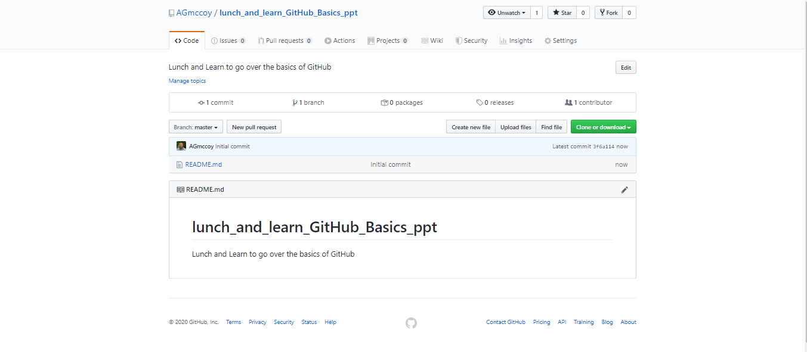
Congrats, your repository is made!

Slide 8
Adding files to your repository

Slide 9
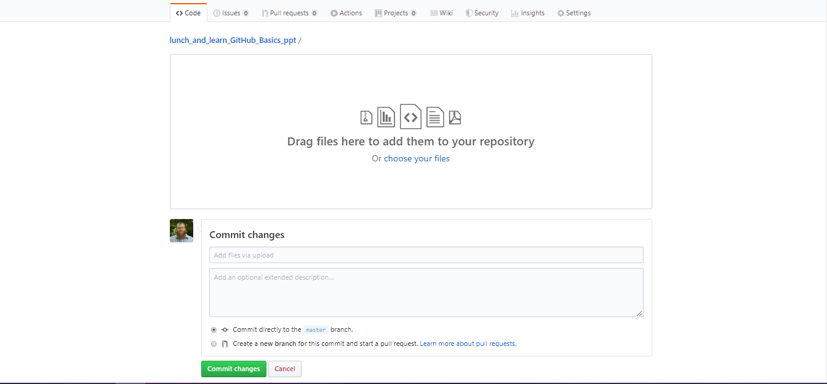
Notes:
If adding files I commit directly to the branch, when I make edits to those files I create a branch

Slide 10
Making a commit (change) to your README
Reminder: Edits to readme changes what shows up here
Notes:
Click on your read me file

Slide 11
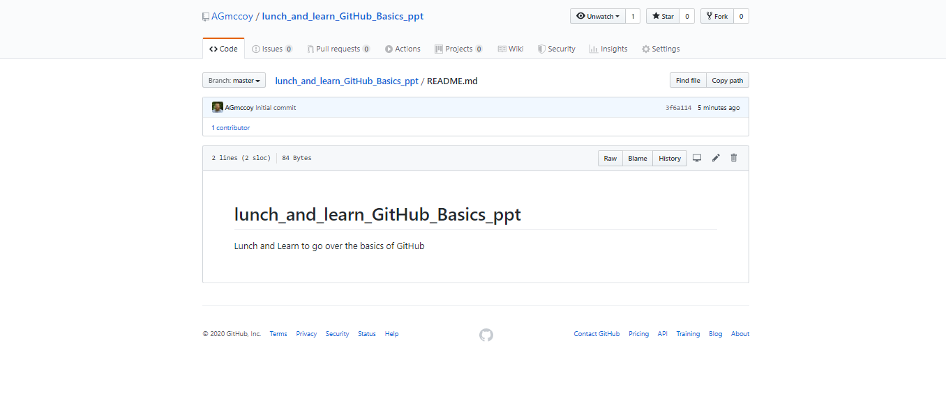
Notes:
Click on the pencil and make your edits

Slide 12
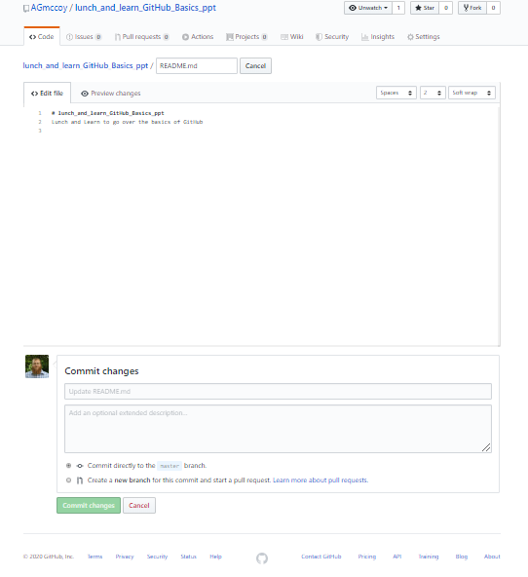
Notes:
Commiting to master branch vs devel branch
Master branch is the fully functioning branch where the code works and is in a stable form. Don’t directly commit changes here unless they are minor
Devel branch is where you make big changes to the code, play around with the code, add new things, make it more concise, etc.
When you’ve done something on the dev branch and want to save it, you do whats called a merge & a pull request with the master branch.

Slide 13
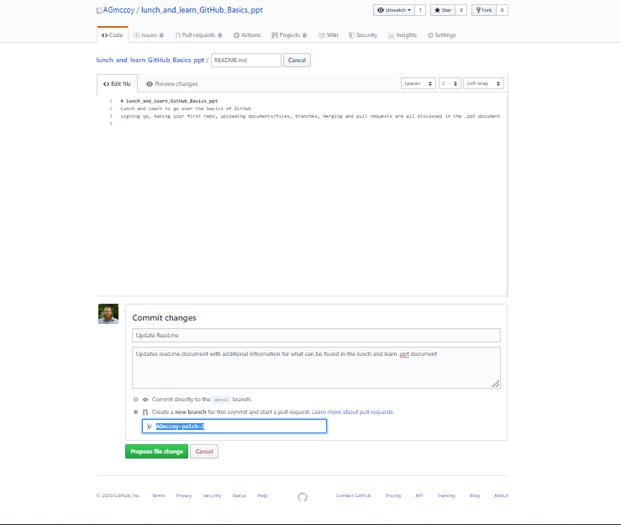
Merging file changes
Notes:
Merging a side branch with the master branch saves all changes you made in the side branch, in the master branch (new save basically)
Start by making edits to your Read.me file, then when commiting changes – make a new branch
You can also commit changes directly, I would only do this when it is a very small grammatical or some other small change.

Slide 14
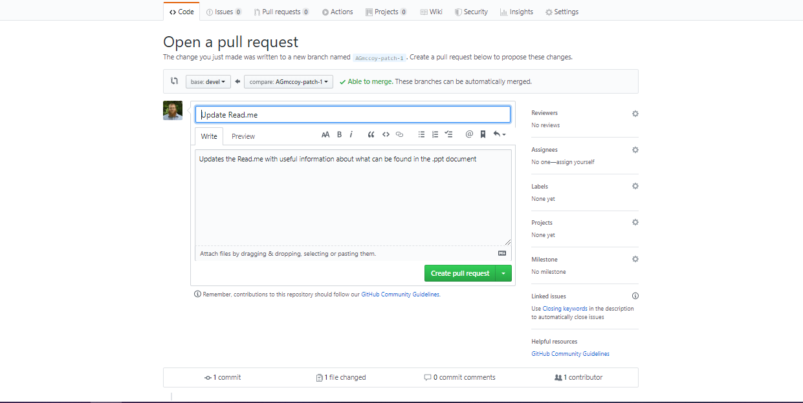
Merging file changes - Open a pull request

Slide 15
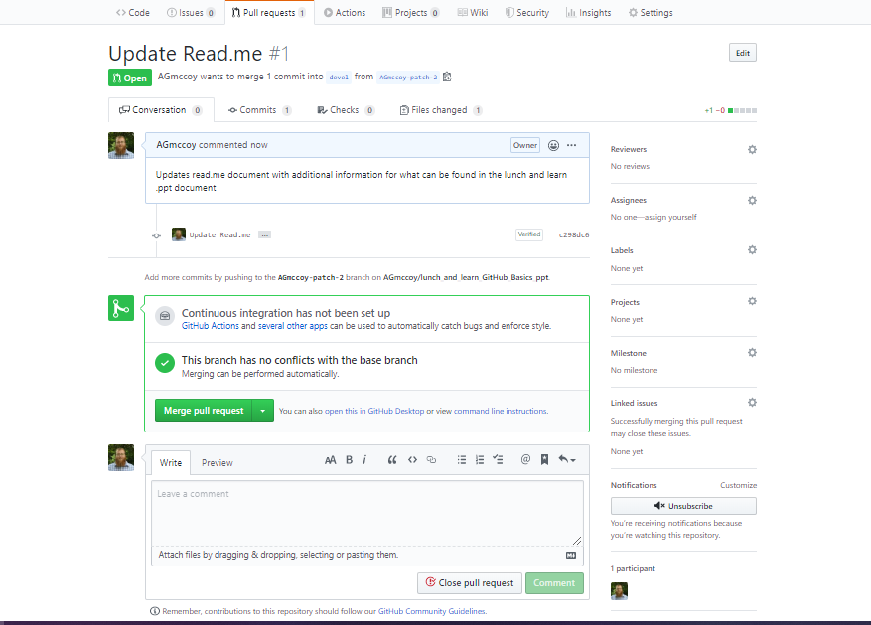
Merging the pull request
Notes:
Click the button and you edits will now be part of the side branch!

Slide 16
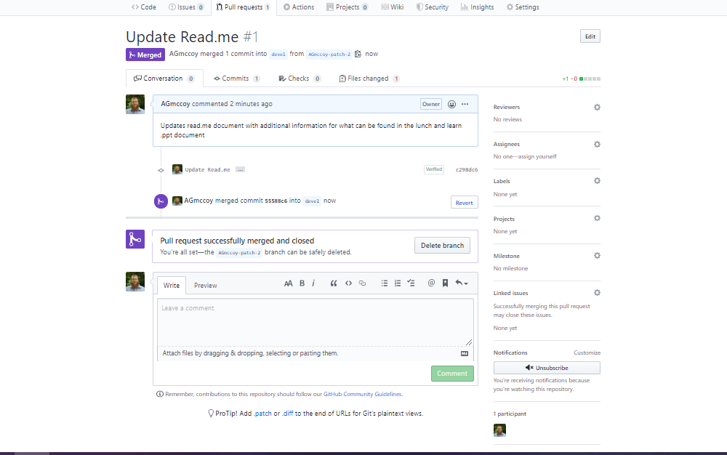
Merged!

Slide 17
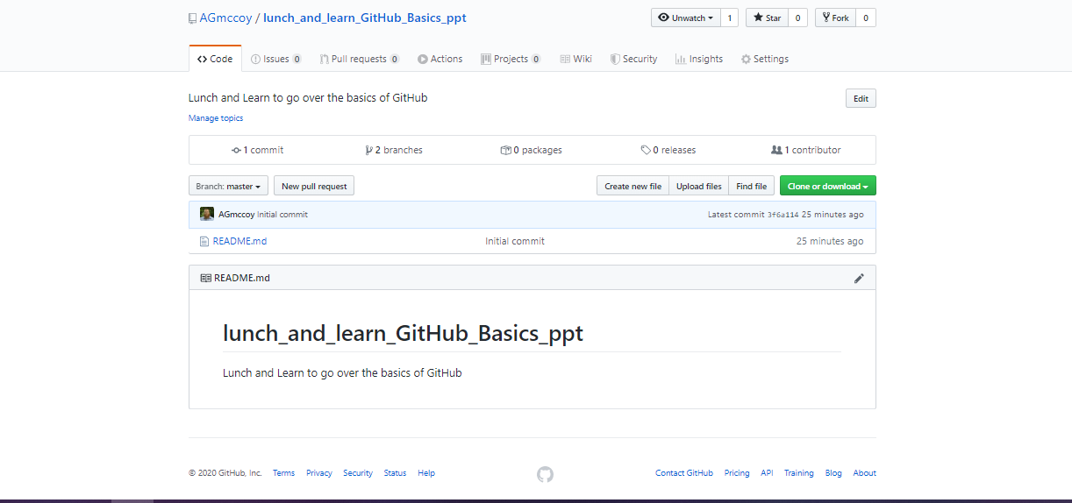
Creating a branch on Github
Notes:
Click on the branch button
Type in your desired branch name, hit enter
Congrats, you just made a branch!
Branches are useful for when you want to play around or edit your code, but don’t want to break it. Consider it a copy of your original document, guaranteed to work just like the original, until you change it. Changes in branches to not effect the master branch without merging the two

Slide 18
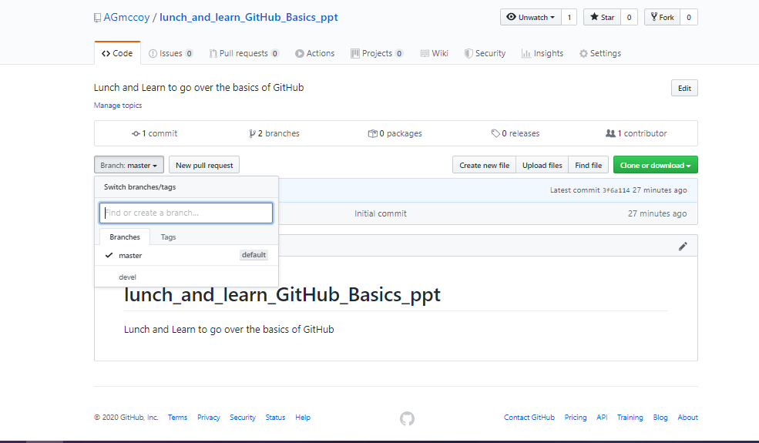
Notes:
Now you have two options for branches!
Remember: use your side branch for when you are wanting to experiment with code, keep your Master branch in its original, functioning, state until you make edits you want to keep

Slide 19
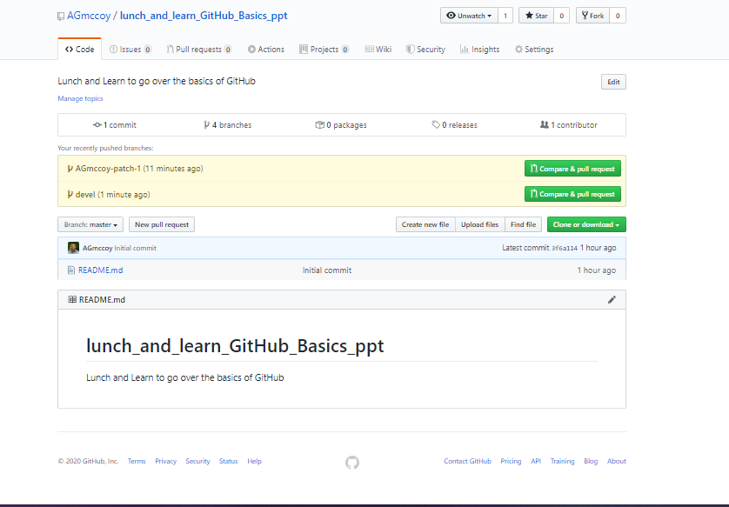
Merging side branches with master branch
Notes:
After making edits and commiting them to the devel branch, you may decide you want those changes implemented into your master branch (up to date, functioning code). This may be due to a change in code, or a change in your read.me, license, supplementary files, etc. Make sure you are making good descriptions for what you are changing when merging edits and branches, youll likely come back to this in following years, or someone else will need it!

Slide 20
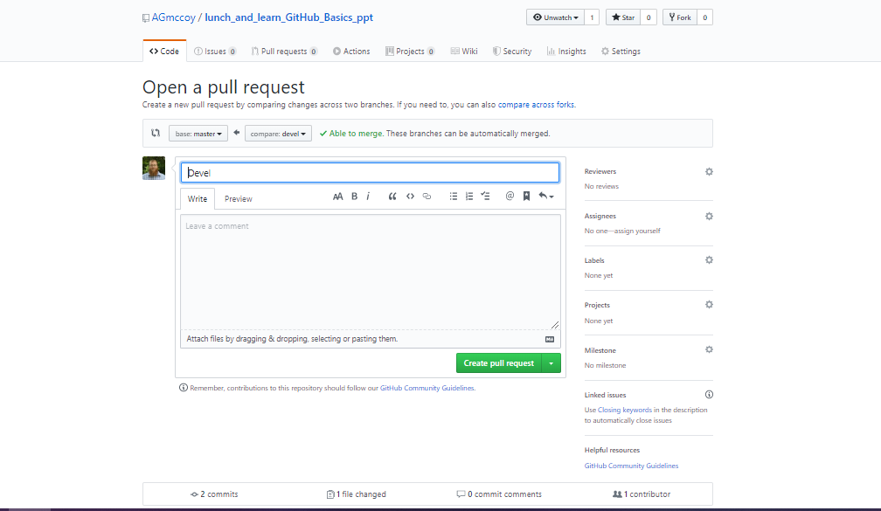
Opening a pull request with devel branch

Slide 21
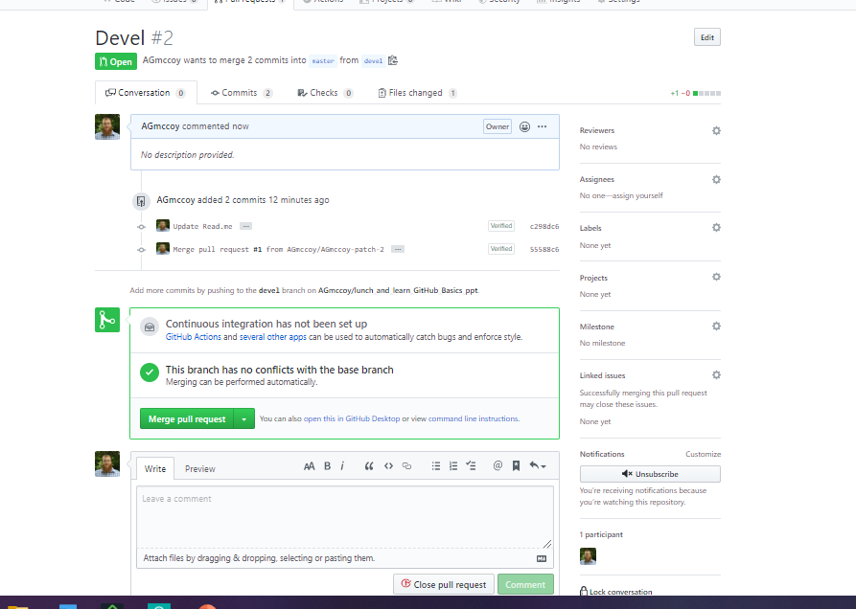
Merging pull request to master branch

Slide 22
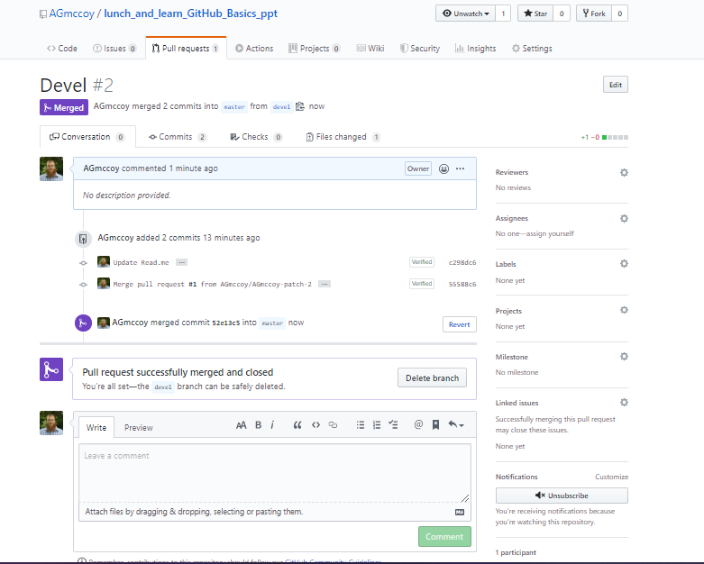
All edits incorporated into Master branch
Notes:
Now you can safely delete the devel branch, all updates have been incorporated into the master branch

Slide 23
Forking
Forking essentially makes a copy of a repository directly to your profile.
Allows you to edit your copy, without disturbing the original
Try forking over the lunch and learn github repository to your profile, so you can have these slides!
Notes:
Forking basically makes a copy of someone elses repository and adds it to your repository so that you may make edits on the same version they are using.
Also a good way to save code you find, and want to test, for later!!

Slide 24
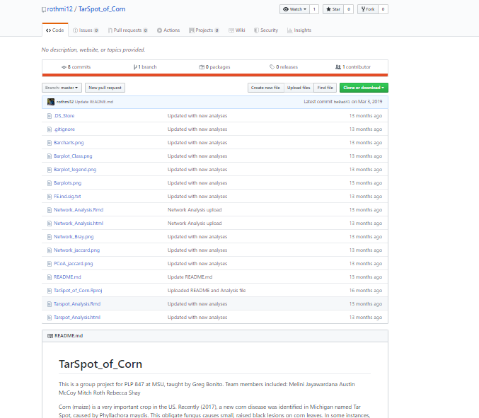
Notes:
Choose your profile and it will download the repository there for you to use.
Very helpful when just getting started on coding for a project/ doing new analyses that you found a github for and want to try

Slide 25
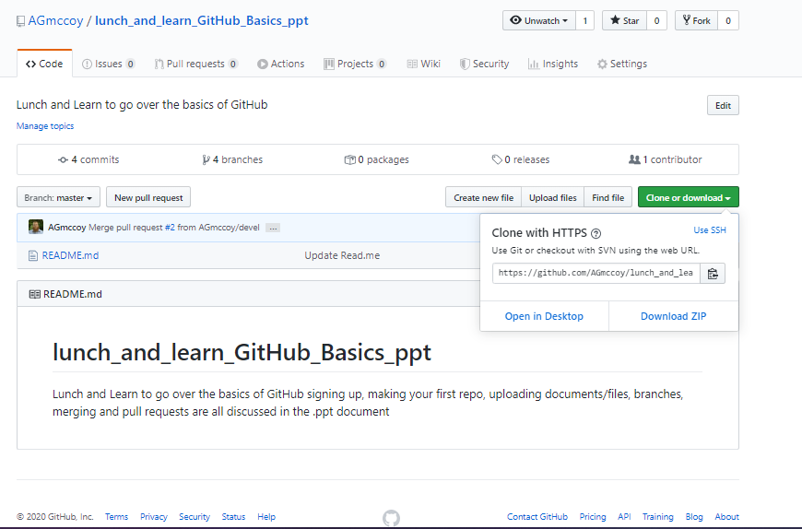
Cloning/downloading a repository
Notes:
When you want to use the code from the repository, you can clone/download the entire repository with the click of a button. I usually download as a ZIP then unpack in my folder of choice to keep things organized.
Also, For when you mess up your code and cant figure out what happened, this is a “do over” button. You can clone(download) your repository in the state it was in, last time it was updated. It sounds silly, but it does happen…

Slide 26
I hope this helped!

